Slide 1
Java Servlets
Day 11

Slide 2
Objectives
    In this lesson you will learn about:
      Need for servlets
      Classes and interfaces to develop servlets
      Servlet life cycle methods
      Steps to develop and deploy a servlet

Slide 3
Servlet Concepts
  Java Servlets are:
    Server side programs written in Java.
    Deployed in a Web container of an application server which provides a runtime environment for servlets.
    Executed when the J2EE application server receives a client request that is passed to the Web container, which in turn invokes the servlet.

Slide 4
Servlet Concepts (Contd.).
  Features of Java Servlets are:
    Security: Inherits the security feature provided by the Web container.
    Session Management: Maintains the identity and state of an end user across multiple requests.
    Instance persistence: Enhances the performance of the server by preventing frequent disk access.

Slide 5
The Servlet Class Hierarchy and Life Cycle Methods
  The Servlet Class Hierarchy consists of two top level interfaces which are implemented by the GenericServlet class:
    javax.servlet.Servlet
    javax.servlet.ServletConfig
  The GenericServlet class is extended by the HttpServlet class which in turn is extended by a user defined class.

Slide 6
The Servlet Class Hierarchy and Life Cycle Methods (Contd.)
  The Servlet Life Cycle includes:
    Initialization of servlet instance using the init() method.
    Servicing a client request using the service() method.
    Destroying a servlet instance using the destroy() method.

Slide 7
The Servlet Class Hierarchy and Life
Cycle Methods (Contd.)
  The sequence in which the Web container calls the life cycle methods of a servlet are:
    The Web container loads the servlet class and creates one or more instances of the servlet class.
    The Web container invokes the init() method of the servlet instance during initialization of the servlet. The init() method is invoked only once in the servlet life cycle.
    The Web container invokes the service() method to allow a servlet to process a client request.

Slide 8
The Servlet Class Hierarchy and Life
Cycle Methods (Contd.)
    4. The service() method processes the request and returns the response back to the Web container.
    5. The servlet then waits to receive and process subsequent requests as explained in steps 3 and 4.
    6. The Web container calls the destroy() method before removing the servlet instance from the service. The destroy() method is also invoked only once in a servlet life cycle.

Slide 9
Creating the Servlet
  Creating the Servlet involves:
    Coding the Servlet: Includes reading and processing a client request and sending the response back to the client.
    Compiling the Servlet: Include the j2ee.jar file in the classpath and compile the servlet to generate a .class file.
r

Slide 10
Creating the Servlet (Contd.)
  Creating the Servlet involves (Contd.):
    Packaging the Servlet: Creates the deployment descriptor that contains the configuration information about the Web application in which it resides. It packages the servlet in a WAR file and deploy it in the server using the deploytool.
    Accessing the Servlet: Calls the servlet from the client browser by typing the servlet’s URL in the address bar of the browser.

Slide 11
Demonstration-Implementing a Servlet Application
  Problem Statement
    Smart Software Developers wants to develop a Web application that will use servlets to display employee information stored in the Employee_Master table. The application needs to have a user interface in which a user can specify an employee id to view the data of the employee. The interface should also display the number of times this Web site has been visited.

Slide 12
Demonstration-Implementing a Servlet Application(Contd.)
  Solution
    Create a user interface using HTML.
    Code and compile the servlet.
    Package the servlet into a J2EE application.
    Deploy the J2EE Application.
    Test the servlet by invoking it from the browser.

Slide 13
Objectives
  In this lesson, you will learn about:
    Classes and interfaces of Servlet API
    Servlet lifecycle events
    Deployment descriptor elements

Slide 14
The Servlet API
  The Servlet API consists of:
    javax.servlet package contains:
      ServletRequest Interface
      ServletResponse Interface
      ServletContext Interface
    javax.servlet.http package contains:
      HttpServletRequest Interface
      HttpServletResponse Interface
      HfttpSession Interface

Slide 15
The Servlet API (Contd.)
  The following table describes the various methods defined in the ServletRequest interface:
Method
Description
public String getParameter(String paramName)
Returns a String object that specifies the value of a particular request parameter.
public String[] getParameterValues(String paramName)
Returns an array of String objects that contains all the values of the request parameter.
public Enumeration getParameterNames()
Returns an Enumeration containing all the parameter names as String objects that a servlet request contains.

Slide 16
The Servlet API (Contd.)
  Methods of ServletRequest interface (Contd.):
Method
Description
public String getRemoteHost()
Returns a String that specifies the full-qualified name of the computer from which the request is sent.
public String getRemoteAddr()
Returns a String that specifies the IP address of the computer from which the request is sent.

Slide 17
The Servlet API (Contd.)
  The following table describes the various methods defined in the ServletResponse interface:
Method
Description
public ServletOutputStream getOutputStream() throws IOException
Returns an object of the ServletOutputStream class that represents an output stream to send binary data as response.
public PrintWriter getWriter() throws IOException
Returns an object of the PrintWriter class that the servlet uses to send character data as response.
public void setContentType(String type)
Sets the MIME type for a servlet response, such as text/plain, image/jpeg and text/html.

Slide 18
The Servlet API (Contd.)
  The following table describes the various methods defined in the ServletContext interface:
Method
Description
public void setAttribute(String, Object)
Binds the object with a name and stores the name/value pair as an attribute of the ServletContext object. If an attribute already exists, then this method replaces the existing attribute.
public Object getAttribute(String attrname)
Returns the Object stored in the ServletContext object with the name passed as a parameter.

Slide 19
The Servlet API (Contd.)
  Methods of ServletContext interface (Contd.):
Method | Description
public Enumeration getAttributeNames() | Returns an Enumeration of String object that contains names of all the context attributes.
public String getInitParameter(String pname) | Returns the value of the initialization parameter with the name passed as a parameter.
public Enumeration getInitParameterNames() | Returns an Enumeration of String object that contains names of all the initialization parameters.

Slide 20
The Servlet API (Contd.)
  Methods of ServletContext interface (Contd.):
Method | Description
public int getMajorVersion() | Returns an integer value that specifies the major version of the Servlet API that the Web container supports. If your Web container supports the version 2.4 of the servlet API, this method will return 2.
public int getMinorVersion() | Returns an integer value that specifies the minor version of the servlet API that the Web container supports. If your Web container supports the version 2.4 of the servlet API, this method will return 4.

Slide 21
The Servlet API (Contd.)
  The following table describes the various methods defined in the HttpServletRequest interface:
Method
Description
public String getHeader(String fieldname)
Returns the value of the request header field such as Cache-Control and Accept-Language specified in parameter.
public Enumeration getHeaders(String sname)
Returns all the values associated with a specific request header as an Enumeration of String objects
public Enumeration getHeaderNames()
Returns the names of all the request headers that a servlet can access as an Enumeration of String objects.

Slide 22
The Servlet API (Contd.)
  The following table describes the various methods defined in the HttpServletResponse interface:
Method
Description
void setHeader(String hname, String hvalue)
Sets the value of header, hname to hvalue. If the header has already been set, the new value overwrites the existing value.
void setIntHeader(String hname, int hvalue)
Sets the value of the header, hname to the int value, hvalue. If the header has already been set, the new value overwrites the existing value.

Slide 23
The Servlet API (Contd.)
  Methods of HttpServletResponse interface (Contd.):
Method | Description
void setDateHeader(String hname, long datev) | Sets the value of the header, hname with a long value datev. The datev represents the number of milliseconds since the midnight of January 1, 1970, GMT.
void addHeader(String hname, String hvalue) | Adds a header, hname with value, hvalue. This method adds a new header if the header already exists.
void addIntHeader(String hname, int hvalue) | Adds a header, hname with an integer value, hvalue.

Slide 24
The Servlet API (Contd.)
  Methods of HttpServletResponse interface (Contd.):
Method | Description
void addDateHeader(String hname, long datev) | Adds a header, hname with value equal to given date, datev. The value of datev must be in milliseconds, which starts since midnight, January 1,1970, GMT.
boolean containsHeader(String hname) | Returns true if the header, hname has already been set with a specific value and false, if not.
void sendRedirect(String url) | Redirects a request to the specified URL.

Slide 25
The Servlet API (Contd.)
    The following table describes the various methods defined in the HttpSession interface:
Method
Description
public void setAttribute(String name, Object value)
Binds the object with a name and stores the name/value pair as an attribute of the HttpSession object. If an attribute already exists, then this method replaces the existing attribute.
public Object getAttribute(String name)
Retrieves the String object specified in the parameter, from the session object. If no object is found for the specified attribute, then the getAttribute() method returns null.
public Enumeration getAttributeNames()
Returns an Enumeration that contains the name of all the objects that are bound as attributes to the session object.

Slide 26
Demonstration-Implementing Context Initialization Parameter
  Problem Statement
    Smart Softwares wants to develop a Web application that will use servlets to provide the information about the company. The servlets, which are created for handling the presentation logic, needs to display an email-id where an end user can send feedbacks and suggestions. The company wants to avoid changing the application code, whenever the email-id of the company changes.

Slide 27
Demonstration-Implementing Context Initialization Parameter (Contd.)
  Solution
    Create a servlet to retrieve initialization parameters.
    Specify the initialization parameters.
    Access the servlet.

Slide 28
Servlet Life Cycle API
  Types of Events generated during the life cycle of a servlet are:
    Servlet Request Events: Relates to changes in the request objects associated with a Web application.
    Servlet Context Events: Relates to changes in the in the context of a Web application.
    HTTP Session Events: Relates to changes in the session object of a servlet application.

Slide 29
Servlet Life Cycle API (Contd.)
  Handling of Servlet Life Cycle Events
    The classes that receive notification about the servlet life cycle events are known as event listeners.
    Various event listener interfaces are:
      ServletRequestListener Interface
      ServletRequestAttributeListener Interface
      ServletContextListener interface
      ServletContextAttributeListener Interface
      HttpSessionListener Interface
      HttpSessionAttributeListener Interface
      HttpSessionActivationListener Interface

Slide 30
Demonstration-Implementing Servlet Life Cycle Events
  Problem Statement
    David Wong, the administrator at Smart Software Developers want to create an application that will log the time when request and context objects are initialized and when attribute is added to the context object. At the same time, the application should also log the time when the attribute is removed from the context object and request and context objects are destroyed.

Slide 31
Demonstration-Implementing Servlet Life Cycle Events (Contd.)
  Solution
    Create a servlet that adds an attribute to context object.
    Create a servlet that logs the time of all the events generated by first servlet to the server.log file.
    Deploy the two servlets. While deploying, register the second servlet to listen to the events generated by first servlet.
    Run the program.

Slide 32
Understanding Elements of Deployment Descriptor
  A deployment descriptor is an XML file with the name web.xml that contains configuration information of a Web application.
  Each Web application contains one web.xml file.
  The elements of the web.xml file enable you to specify:
    Initialization parameter for the servlet
    MIME type for different files
    Listener classes
    Mapping a URL pattern to a servlet

Slide 33
Understanding Elements of Deployment Descriptor (Contd.)
    Various deployment descriptors are:
      <context-param>
      <init-param>
      <mime-mapping>
      <servlet-mapping>

Slide 34
Summary
In this lesson, you learned:
  Servlet is a server-side program written in Java that dynamically extends the functionality of an application server.
  J2EE 1.4 application server deploys J2EE Web components inside a Web container, which provides runtime environment for servlets.
  The classes and interfaces, which are used to develop a servlet, are packaged in the javax.servlet and javax.servlet.http packages of the servlet API.
  A servlet can be developed by extending the HttpServlet class, if the client is using an HTTP protocol for sending the request to the servlet.
  The javax.servlet.Servlet interface defines methods that are used to manage the servlet life cycle.

Slide 35
Summary (Contd.)
  The javax.servlet.ServletConfig interface is implemented by a Web container to pass configuration information to a servlet.
  The javax.servlet.Servlet interface defines the life cycle methods of servlets, such as init (), service (), and destroy ().
  The init() method of the servlet instance is invoked during initialization of the servlet by the Web container.
  The Web container invokes the service() method of the servlet instance when the Web container receives a client request.
  The Web container calls the destroy() method before removing a servlet instance from service.

Slide 36
Summary (Contd.)
  The tasks involved in creating and running a servlet are:
    Code and compile the servlet
    Package the servlet into a J2EE application
    Deploy the J2EE Application
    Access the servlet from a browser
  An HttpServletRequest object represents a request sent by a client using HTTP.
  An HttpServletResponse object represents a response sent by a servlet instance to a client using HTTP.

Slide 37
Knowledge Byte
  In this section, you will learn about the following:
    Types of J2EE Containers
    Various HTTP Methods

Slide 38
Types of J2EE Containers
  Various types of J2EE components are:
    Servlets
    Java Server Pages (JSP)
    Applets
    Enterprise JavaBeans (EJB)

Slide 39
Types of J2EE Containers (Contd.)
  Various types of J2EE containers for each type of J2EE components are:
    Web container: Provides a runtime environment to manage deployed Web components, such as servlets and JSP.
    Applet container: Provides the runtime environment for executing applets.
    EJB container: Provides a runtime environment to manage deployed EJB components.
    Application client container: Provides a runtime environment for J2EE application clients.

Slide 40
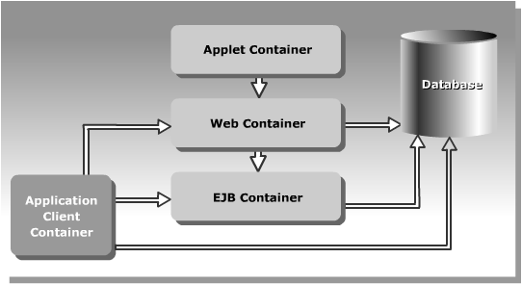
Types of J2EE Containers (Contd.)
  The following figure shows the interaction between different J2EE containers:

Slide 41
Types of J2EE Containers (Contd.)
  Some of the J2EE compliant application servers that are available in the market are:
    WebLogic application server from BEA Systems.
    WebSphere application server from IBM
    Sun ONE application server from Sun Microsystems, Inc

Slide 42
Various HTTP methods
  The HTTP protocol supports various types of request, such as GET, POST, PUT, HEAD, DELETE, TRACE, and OPTIONS that are used by clients to request data.
  All these HTTP requests are handled by the service() method, which is defined in the HttpServlet class.
  The HttpServlet class defines all the methods supported by HTTP protocol to which the service() method delegates the requests to handle the specific client requests.
  These methods are of the form doXXX() where XXX corresponds to the specific HTTP requests.
  The various methods that are defined in the HttpServlet class are doGet(), doPost(), doPut(), doDelete(), doTrace(), and doOptions().

Slide 43
Various HTTP methods (Contd.)
  The HTTP PUT Request Method is:
    Primarily designed for the client to upload a file to the ftp server.
    Mapped to the doPut() method of the HttpServlet class.
    Triggered when you submit an HTML form with the METHOD attribute of the Form tag set to PUT.
  The HTTP DELETE Request Method is:
    Used to delete a resource from the server. For example, a client can use the DELETE method to delete a Web page from the server.
    Mapped to the doDelete() method of the HttpServlet class.
    Used to handle requests that are sent using the DELETE method.

Slide 44
Various HTTP methods (Contd.)
  The HTTP TRACE Request Method is:
    Primarily designed for the client to request for the loop-back data of the previous requests made by the client.
    Used by the client to determine the path that the data has taken, from source to destination during transmission using the loop-back data.
    Mapped to the doTrace() method of the HttpServlet class.
    Used for debugging and returns the content type, message size, and the message associated with the previous requests.
  The HTTP OPTIONS Request Method is:
    Used to obtain information about the HTTP methods that the server supports.
    Mapped to the doOptions() method of the HttpServlet class.

Slide 45
From the Expert’s Desk
  This section will introduce the following:
    Best practice on upgrading a static Web site to provide dynamic output using servlets
    Tips on handling HTTP methods
    Tips on caching servlets
    FAQs on advantages of JNDI and deployment descriptors

Slide 46
Best Practices
Upgrading a Static Web Site to Provide Dynamic Output Using Servlets
  Avoid displaying static content in a servlet.
  Define static content in the init() method, if a servlet needs to display both static and dynamic content.
  Append the static content to the dynamic content defined in the doGet() or doPost() method before sending it as a response.
  Flush the response buffer explicitly by using the flush() method of the ServletOutputStream class while sending large amount of binary response.
  Explicit flush the response buffer to intermittently allow the client to start partly displaying the content instead of waiting for the entire content to arrive.

Slide 47
Tips
Handling HTTP Methods
  At times, while working with servlet applications, you are not sure of whether the client is making a GET request or a POST request.
  In such a situation, the server returns a response that the particular method is not supported by the servlet.
  To avoid such instances:
    Provide request handling code inside doPost() method.
    Call the doPost() method from within the doGet() method.
  This will ensure that the client request is always serviced no matter which method is invoked.

Slide 48
Tips (Contd.)
Caching Servlets
  Stores recently accessed data in the memory of the client machine, so that it can be used for future requests.
  Reduces the time between a client request and the servlet response.
  Reduces the network traffic as the browser can display a cached servlet response to the client, instead of sending the request to the application server for the servlet.

Slide 49
Tips (Contd.)
Caching Servlets (Contd.)
  Caching using servlet is done through two HTTP headers, Last-Modified and If-Modified-Since.
  The server adds a Last-Modified header to the response to indicate the last modification time of the servlet.
  When the browser sends a subsequent request for the same servlet to the server, the browser adds a If-Modified-Since header to the request with the time received in the Last-Modified header.
  When the server receives the browser request, the server compares the values of both the headers to check for any difference in the value.

Slide 50
Tips (Contd.)
Caching Servlets (Contd.)
  If no difference is found, the server sends a status code to the browser, which indicate that the browser can display the previous output stored in the browser cache.
  A difference in the value of Last-Modified and If-Modified-Since headers indicate a change in the servlet content.
  The server then needs to re-send the modified servlet output to the browser along with modified time of servlet output in the Last-Modified header.

Slide 51
Tips (Contd.)
Caching Servlets (Contd.)
  You can programatically control how a browser caches your servlet content by overriding the getLastModified() method of the HttpServlet class.
  When the server receives a request for a servlet from a browser with If-Modified-Since header, the server calls the getLastModified() method to retrieve the last modified time of the servlet.
  The server then compares the time returned by the getLastModified() method with the time stored in Last-Modified header.
  If there is no difference in the time of two header values, a status code is sent to the browser to display the servlet output from the browser cache.
  Otherwise, a call to service() method of the servlet is made to send a response to the browser with a new value to Last-Modified header.

Slide 52
FAQs
  What is the advantage of using JNDI data source lookups instead of DriverManager code to obtain a data source in Web applications?
    JNDI
      Provides location transparency to objects.
      Does not necessitates the client to be aware of the location of the object.
      Enables a servlet, which accesses a database, to obtain a connection by performing a JNDI lookup on the data source configured on the application server.
      Does not require you to make any change in the servlet, if the data source properties, such as the driver, URL, user name, and password changes.

Slide 53
FAQs (Contd.)
  What is the advantage of using JNDI data source lookups instead of DriverManager code to obtain a data source in Web applications? (Contd.)
    DriverManager requires you to:
      Hard code information, such as driver name and JDBC URL to access a database.
      Provide user credentials such as username and password to access the data source, which can raise security issues.

Slide 54
FAQs (Contd.)
  How does a servlet obtain information from the deployment descriptor?
    When a Web application is deployed, the Web container obtains the information from the deployment descriptor and initializes a ServletConfig object and a ServletContext object with it.
    The container passes the ServletConfig object to the init() method of the servlet to initialize it.
    The servlet can obtain information, such as its initialization parameter using the ServletConfig object.
    The servlet can then call methods of the ServletContext object to obtain information, such as the context initialization parameters that was specified in the deployment descriptor.

Slide 55
FAQs (Contd.)
  How does a Web component deployment descriptor differs from the Application Server deployment descriptor?
    Web component deployment descriptor:
      Is a standard web.xml file, which is stored in the WEB-INF directory of a Web component WAR file.
      Contains component specific information, such as, name of servlet, class file of servlet, URL mapping, error pages, initialization parameters, and listeners.
    Application deployment descriptor:
      Is the standard application.xml file, which is stored in the top level of the META-INF directory of a J2EE application EAR file.
      Contains information of the J2EE application, such as the different Web modules the application contains and their context root.

Slide 56
FAQs (Contd.)
  How does a Web component deployment descriptor differs from the Application Server deployment descriptor? (Contd.)
    Application server-specific deployment descriptor
      Is an application server-specific XML file that allows you to specify how the application server needs to deploy your Web application.
      For example, the J2EE application server provides the sun-web.xml deployment descriptor for handling deployment of Web components.
      You can configure properties specific to the J2EE application server in this deployment descriptor.
      For example, you can specify whether the server needs to cache your servlet and the time for which the servlet needs to be in cache.

Slide 57
Objectives
    In this lesson, you will learn about:
    Creating and managing user sessions
    Handling errors and exceptions

Slide 58
Session Management
  Session management refers to tracking the state of an end user across Web pages.
  Session management enables programmers to create applications where the state of an end user is required to be maintained across multiple Web pages.

Slide 59
Session Management (Contd.)
  The techniques for managing the state of an end user are:
    Hidden form field
    URL rewriting
    Cookies
    Servlet session API

Slide 60
Session Management (Contd.)
  Hidden Form Field is:
    Simplest technique to maintain the state of an end user.
    Embedded in an HTML form.
    Not visible when you view an HTML file in a browser window.
    Not able to maintain the state of an end user when it encounters a static document.

Slide 61
Session Management (Contd.)
  URL Rewriting:
    Maintains the state of end user by modifying the URL.
    Is used when the information to be transferred is not critical.
    Cannot be used for maintaining the state of an end user when a static document is encountered.

Slide 62
Session Management (Contd.)
  Cookies:
    Are chunks of information created by the server and are stored by the browser on the client machine.
    Supported by the Web browser and the size of each cookie is maximum of 4 bytes.
    Are used by the server to find out the computer name, IP address, or any other details of the client computer.

Slide 63
Session Management (Contd.)
  The following table describes the methods defined in the Cookie class:
Method
Description
public String getName()
Returns the name of the cookie.
public void setMaxAge(int expiry)
Sets the maximum time for which the client browser retains the cookie value.
public int getMaxAge()
Returns the maximum age of the cookie in seconds.
public void setValue(String value)
Sets a new value to the cookie.
public String getValue()
Returns the value of the cookie.

Slide 64
Session Management (Contd.)
  The Servlet Session API provides various interfaces and classes, which can be used for managing end user sessions. The interfaces defined in the Servlet Session API are:
    javax.servlet.http.HttpSession
    javax.servlet.http.HttpSessionListener
    javax.servlet.http.HttpSessionBindingListener

Slide 65
Session Management (Contd.)
  The following table describes the various methods defined in the HttpSession interface:
Method
Description
public void setAttribute(String name, Object value)
Binds an attribute to a session object with a unique name and stores the name/value pair in the current session. If an object is already bound with the same attribute, then the new object replaces the existing object.
public Object getAttribute(String name)
Retrieves the object bound with the attribute name specified in the method, from the session object. If no object is found for the specified attribute, then the getAttribute() method returns null.

Slide 66
Session Management (Contd.)
  Methods of HttpSession interface (Contd.):
Method
Description
public Enumeration getAttributeNames()
Returns the name of all the objects that are bound to the session object.
public void removeAttribute(String name)
Unbinds the session object from the attribute, name specified in the method.
public void setMaxInactiveInterval(int interval)
Sets the maximum time for which the session will remain active. The time is specified in seconds.

Slide 67
Session Management (Contd.)
  Methods of HttpSession interface (Contd.):
Method
Description
public int getMaxInactiveInterval()
Returns the maximum time in seconds for which the server will not invalidate the session even if there is no client request.
public String getId()
Returns a string that contains the unique identifier associated with the session.
public void invalidate()
Invalidates a session. All the objects bound to the session are automatically unbound.

Slide 68
Demonstration-Implementing Session Management using Session API
  Problem Statement
    Larry Williams is in charge of the garments section of Countryside Markets. He receives information stating that the total in the bill is wrong. Larry visits the Web site of his company and does an online shopping. He finds that the bill includes information of only those shirts that he selected on the last Web page he visited. The information of shirts that he selected in the earlier Web pages was lost. Larry asks John, the developer of the company’s Web site, to modify the Web site such that the shirts selected by a user should be tracked and the bill should get updated accordingly. John develops a test application for the customer, Mike to test the functionality.

Slide 69
Demonstration-Implementing Session Management using Session API (Contd.)
  Solution
    Create a user interface.
    Create a servlet that authenticates the user information and displays the product information.
    Create a servlet to store information about the selected items in a servlet.
    Create a servlet to calculate and display the bill.

Slide 70
Handling Errors and Exceptions in Servlets
  The two Servlet Exceptions defined in Servlet API are:
    javax.servlet.ServletException: Defines a servlet exception that a servlet throws while processing the client request.
    javax.servlet.UnavailableException: Defines a servlet exception that is thrown by a servlet, when a servlet is temporarily or permanently unavailable.

Slide 71
Handling Errors and Exceptions in Servlets (Contd.)
  Servlets:
    Can generate errors and throw exceptions in Web applications.
    Provide information to users regarding these errors and exceptions by sending error messages and status codes.

Slide 72
Handling Errors and Exceptions in Servlets (Contd.)
  A status code is the information that the application server sends to the client about the success or failure of a client request. The status codes are logically grouped into following five categories:
    Information: Represents messages about the receipt of a request and that the application server is processing the request.
    Success: Represents a success message, which indicates that the request is successful.
    Redirection: Represents a redirection message, which indicates that the request is redirected to another page for processing and service.

Slide 73
Handling Errors and Exceptions in Servlets (Contd.)
  Categories of status codes (Contd.):
    Client error: Represents a client error, which indicates that the request has some error and cannot be serviced.
    Server error: Represents a server error, which indicates that the server is unable to fulfill the client request.

Slide 74
Handling Errors and Exceptions in Servlets (Contd.)
  The following table describes the signatures of the overloaded sendError() method:
Method
Description
public void sendError(int status)
Accepts an integer field of HttpServletResponse as argument that describes the type of error that occurs and sends the error response to the client.
public void sendError(int status, String message)
Accepts an additional String argument that describes the error and sends the error response to the client.

Slide 75
Handling Errors and Exceptions in Servlets (Contd.)
  The following table describes the signatures of the overloaded setStatus() method:
Method
Description
public void setStatus (int status)
Accepts an integer field of HttpServletResponse as argument that represents the status information and sets the information to the response.
public void setStatus (int status, String message)
Accepts an additional String argument that describes the status of the servlet.

Slide 76
Handling Errors and Exceptions in Servlets (Contd.)
  A customized error page is used to create your own error page in a Web application to display the descriptive exception and error messages.
  To use a custom error page in your Web application, you need to specify the error page mapping in the Error Mapping section of the File Refs tab in the J2EE Deploytool window.

Slide 77
Demonstration-Handling Errors in a Servlet
  Problem Statement
    A user while using the online calculator application enters a non-numeric character to add the numbers. When the servlet tries to convert the value entered by the user into an integer type, it throws an exception of type NumberFormatException. Create a Web application that handles the exception using a customized error page. The customized error page needs to provide information on the exception to the user and log the exception to the server log file.

Slide 78
Demonstration-Handling Errors in a Servlet (Contd.)
  Solution
    Create a user interface.
    Create a servlet.
    Create a customized error page.
    Map the error page to the Web application.
    Test the application.

Slide 79
Summary
  In this lesson, you learned:
  Creating and managing user sessions across multiple Web pages using various techniques, such as hidden form field, cookies, URL rewriting, and Servlet Session API.
  Handling javax.servlet.ServletException and javax.servlet.UnavailableException exceptions using try, catch, and finally blocks.
  How to create a customized error page by using the <error-page> element of the deployment descriptor that handles NumberFormatException exception.
  Five types of status code groups, information, success, redirection, client error, and server error.

Slide 80
Summary (Contd.)
  Using sendError() and setStatus() methods to identify the status of the servlet.
  How to create a Web application that implements session management using the Servlet Session API.

Slide 81
Objectives
  In this lesson you will learn about:
  Inter-servlet communication
  Single-threaded and multi-threaded servlets
  Using servlet filters to modify the request and response objects

Slide 82
Inter-Servlet Communication
  A process where two or more servlets communicates with each other to process the client request.
  A servlet can forward the request to another servlet to process the client request.
  A servlet can include the output of another servlet to process the client request.

Slide 83
Inter-Servlet Communication (Contd.)
  Inter-servlet communication using Request Dispatcher
    A Request Dispatcher:
      Is an object of the javax.servlet.RequestDispatcher interface that allows inter-servlet communication.
      Object is used to include the content of another servlet.
      Object is used to forward the request to another servlet.

Slide 84
Inter-Servlet Communication (Contd.)
  Inter-servlet communication using the Request Object
    Stores the calculated data as attribute to the request object in the first servlet.
    Forwards the request to the second servlet using the RequestDispatcher.
    Retrieves the data from the request object and displays the result using the second servlet.

Slide 85
Demonstration-Creating a Customized Error Page
  Problem Statement
    InfoSuper Inc. has created a dynamic Web site. Whenever an error occurs, the stack trace displayed in the browser is difficult to understand. David Wong, the system analyst of the company asks Don Allen, the software programmer of the company to create a customized error page. Whenever an exception is thrown by a servlet, the servlet dispatches the request to the customized error page. The error page then displays the error in the browser in a more understandable format.

Slide 86
Demonstration-Creating a Customized Error Page (Contd.)
  Solution
    Create a servlet that throws an exception and stores the Exception object as an attribute to the request object. The servlet then forwards the request object to an error page.
    Create a servlet that acts as a custom error page to display the error message.
    Compile and deploy the servlets.
    Run the program.

Slide 87
Servlet Threading Model
  The two types of Servlet Threading Model are:
    Multi-threaded Model
    Single-threaded Model

Slide 88
Servlet Threading Model (Contd.)
  Developing Thread-Safe Servlets
    While developing servlets in a multi-threaded model, threading issues needs to be handled to protect the shared resource. Therefore, we need to identify the types of attributes that are inherently thread-safe and the types that need to be guarded for thread safety.

Slide 89
Servlet Threading Model (Contd.)
  Developing Thread-Safe Servlets (Contd.)
    The Various thread-safe capabilities of attributes, methods, and fields in a servlet are:
      init() and destroy() methods
      local variables
      Request attributes
      Context attributes
      Data stored in session attributes
    The two approaches that can be followed for developing thread-safe servlets are:
      Synchronizing block of codes for accessing a shared resource
      Synchronizing methods for accessing a shared resource

Slide 90
Servlet Filters
  Servlet filters:
    Are objects that intercept the requests and response that flow between a client and a servlet.
    Modify the headers and content of a request coming from a Web client and forward it to the target servlet.
    Intercept and manipulate the headers and contents of the response that the servlet sends back.

Slide 91
Servlet Filters (Contd.)
  The advantages of using servlet filters are:
    You can identify the type of request coming from the Web client, such as HTTP and FTP, and invoke the servlet that needs to process the request.
    You can validate a client using servlet filters before the client accesses the servlet.
    You can retrieve the user information from the request parameters to authenticate the user.
    You can use servlet filters to identify the information about the MIME types and other header contents of the request.

Slide 92
Servlet Filters (Contd.)
  Advantages of using servlet filters are (Contd.):
    You can use servlet filters to facilitate a servlet to communicate with the external resources.
    You can use servlet filters to intercept responses and compress it before sending the response to the client.

Slide 93
Servlet Filters (Contd.)
  Programming of filters include:
    Creating Filters
    Deploying Servlet Filters

Slide 94
Servlet Filters (Contd.)
  Creating Filters
    The following code snippet shows a filter which calculates the time taken by a servlet to process the client request:
    public class ProcessingTimeFilter implements Filter {
    public void do Filter(ServletRequest request, ServletResponse response, FilterChain chain) throws IOException, ServletException {
    long service_Start = System.currentTimeMillis();
    chain.doFilter(request, response);
    long service_Stop = System.currentTimeMillis();
    long serviceTime = (service_Stop - service_Start);
    flt_cnfg.getServletContext().log("Time taken to process request is: “ + serviceTime + " milliseconds");
    }}
      Deploying Filters

Slide 95
Servlet Filters (Contd.)
  Deploying Filters include:
    Adding a filter to the Web application
    Mapping the filter to the Web application

Slide 96
Servlet Filters (Contd.)
  Adding the filter to Web application involves:
    Add the filter to the Web application in the similar way as you add a servlet to a Web application using the deploytool.

Slide 97
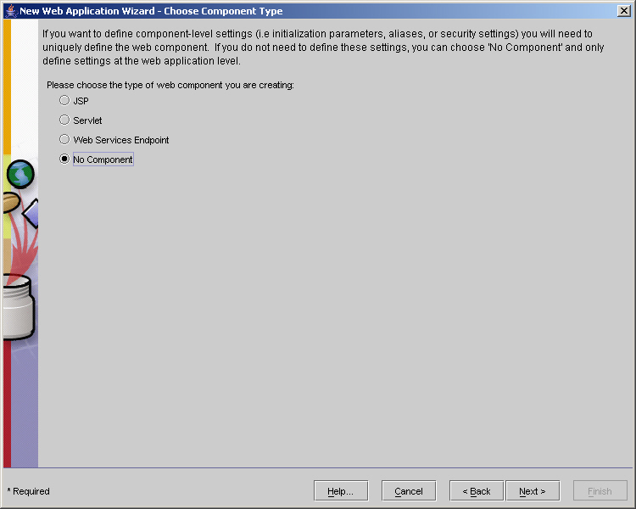
Servlet Filters (Contd.)
    Select the component type as No Component in the New Web Application Wizard - Choose Component Type dialog box of the New Web Application Wizard as shown in the following figure:

Slide 98
Servlet Filters (Contd.)
  Mapping the filter to Web application involves:
    Select the Web application to which you have added the filter class in the J2EE Deploytool window.

Slide 99
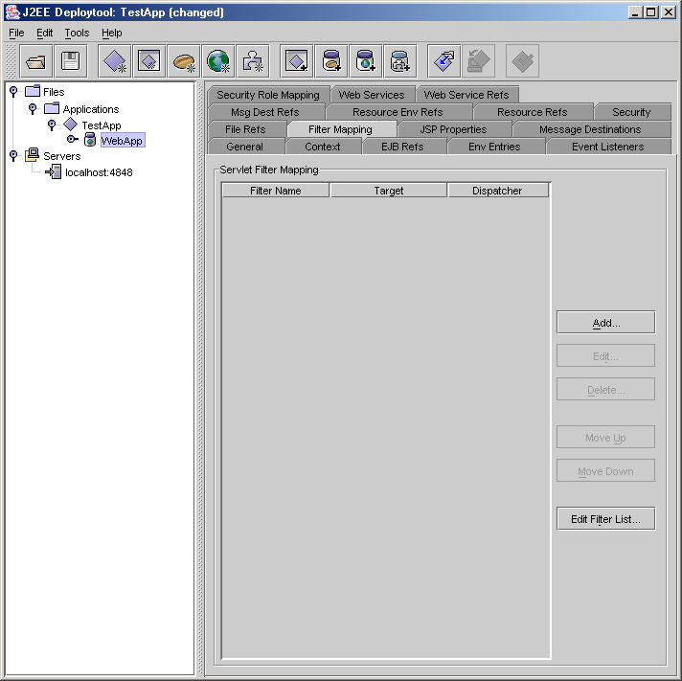
Servlet Filters (Contd.)
      Click the Filter Mapping tab in the right pane of the J2EE Deploytool window to display the Filter Mapping tabbed page, as shown in the following figure:

Slide 100
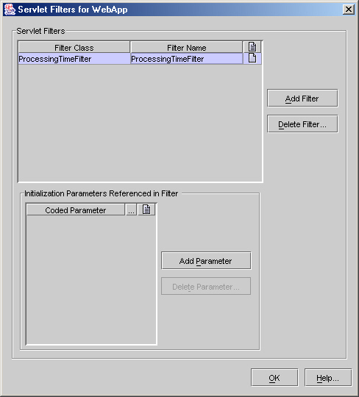
Servlet Filters (Contd.)
    Click the Edit Filter List button to display the Servlet Filters for WebApp dialog box. Click the Add Filter button in the Servlet Filter for WebApp dialog box. Select ProcessingTimeFilter from the drop-down list of the Filter Class column. Specify the name of the filter in the Filter Name column, as shown in the following figure:

Slide 101
Servlet Filters (Contd.)
      Click the OK button to return to the Filter Mapping tabbed page in the J2EE Deploytool window.

Slide 102
Servlet Filters (Contd.)
      Click the Add button under the Filter Mapping tabbed page to display the Add Servlet Filter Mapping dialog box. Select ProcessingTimeFilter from the Filter Name drop-down list. In the Filter Target pane, select the Filter Servlets that match this URL Pattern option and specify /* in the URL Pattern text box. This specifies that the filter needs to intercept all requests and response coming to this Web application. The following figure shows the Add Servlet Filter Mapping dialog box:

Slide 103
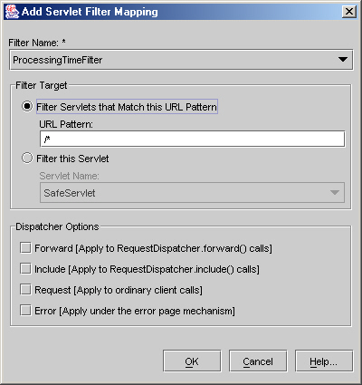
Servlet Filters (Contd.)
      Click the OK button to complete the filter mapping process.

Slide 104
Summary
  In this lesson, you learned:
  Forwarding requests to other servlets using the forward() method of RequestDispatcher.
  Including the content of other servlets in a servlet using the include() method of RequestDispatcher.
  Performing inter-servlet communication using RequestDispatcher and servlet request object.
  Multi-threaded servlet model is the default threading model of a servlet.
  Various functions of a servlet filter are:
    Identifying the type of client browser.
    Identifying the character encoding used by the client browser.

Slide 105
Summary (Contd.)
  Developing servlet filters using Filter interface, FilterConfig interface, ServletRequest interface, and ServletResponse interface.
  Adding filter to a Web application and mapping them to a servlet to filter the contents of a servlet.

